Slide 1
Wildlife
Analysis
Veronika Moroz
DE5 Code Clan
10/2/2020

Slide 2
Plan
Introduction and client’s requirements
Cleaning approach and challenges
Data analysis
Time-Series Forecasting Methods
Summary and future proposals
Questions

Slide 3
About the Project
Synthetic data was created for demo.
Project was done in Python.
Data was given by UK organisation.
Organisation’s aim is to protect animals.
The organisation is interested in injuries:
  Trend by region, time and animal types?
  Trend in advice calls?
  Prediction for 2021?
Notes:
Main analysis was done on injuries.
Also for demo purposes a fake data was mocked up to mimic data that the organisation may collect.
further you will hear insights about synthetic data which mimics original data but different names

Slide 4
Raw Data
Free text data, no numbers.
3 years covered:
  2018, 2019, 2020 (up to May).
  Around 50%, 40%, 10%.
4 main columns:
  Description (!), region, time, animal type.
2-5 unnamed columns in 2018, 2019.
  Shifted data!
Notes:
Time in datetime format.
Explored extra columns and they were found to have data which was shifted to right. As lots of text in description column.

Slide 5
Data cleaning
Combined 3 datasets into one
Filtered shifted data and assigned it manually
  There were issues with dates so left as ‘Unknown’
Missing data:
  Changed to ‘Unknown’ and removed in description as it is key
Call Description:
  Created keyword dictionary such as ‘inj or injuries’
  New column of reasons for call -> injuries, rescue, advice, etc.
New column ‘type_of_calls’ -> advice and report
Final check of all columns
Notes:
Text in extra columns. Removed extra columns. 631 removed due to missing call description.
Checked initial excel file and found that they all had strange values.
(distinguished by time)
and assert that no missing data in all columns

Slide 6
Data Analysis

Slide 7
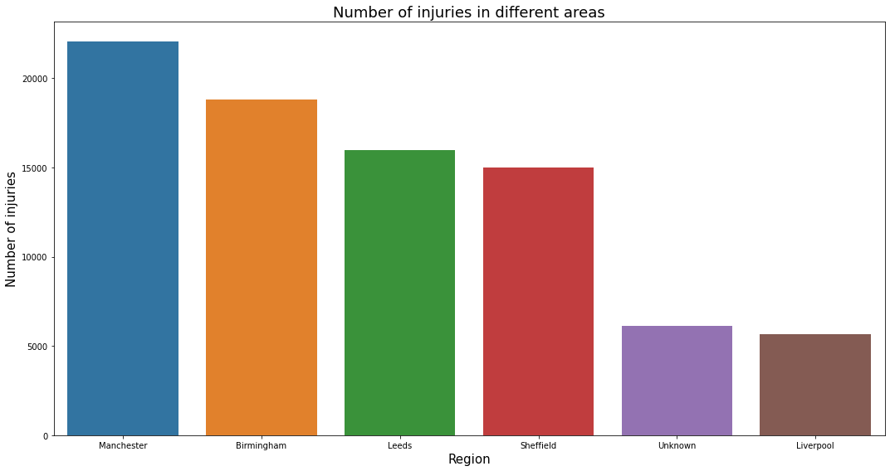
Q1: If there are a trend in injuries By Region, and is there different peaks of times of year per region.
Notes:
Data does not tell why. It is unclear why - more injuries? More active people in Manchester who reports?

Slide 8
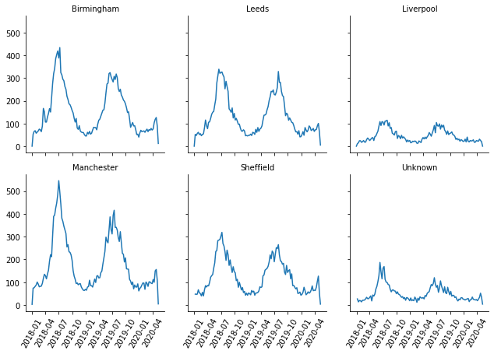
Q1: If there are a trend in injuries By Region, and is there different peaks of times of year per region.
Notes:
All regions have seasonal increase. 2nd peak in summer 2019 is smaller than before.
Perhaps people walk more often and tend to find injured animals more often?

Slide 9
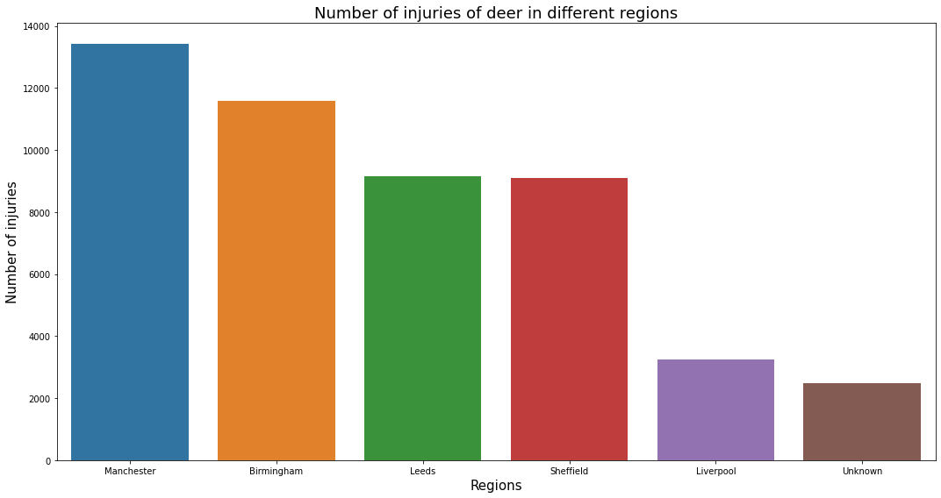
Q2: Analysis on the types of animals that are injured, this also by Region – is there a species that is more liable to injury in certain regions?
Notes:
Around 45% was deer

Slide 10
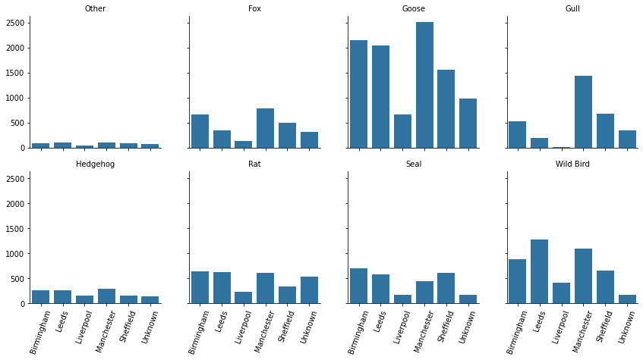
Q2: Analysis on the types of animals that are injured, this also by Region – is there a species that is more liable to injury in certain regions?
Notes:
Gull is two times likely to have injury in Manchester.

Slide 11
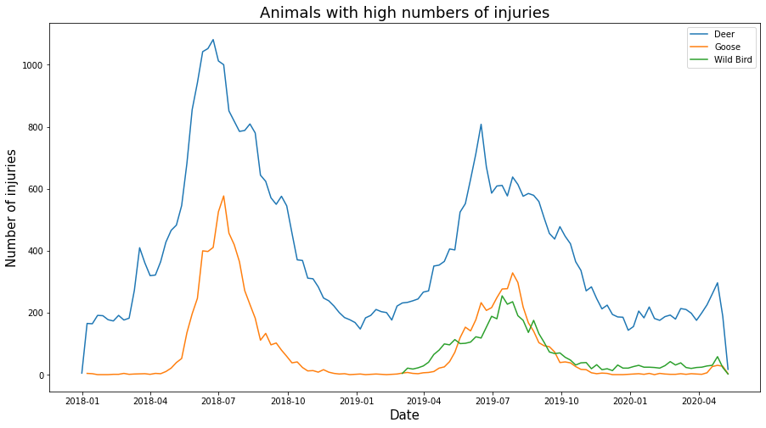
Q2: Species by time of year, which are the animals that are prone to injuries at certain times of the year.
Notes:
Split up the data into high and low injuries

Slide 12
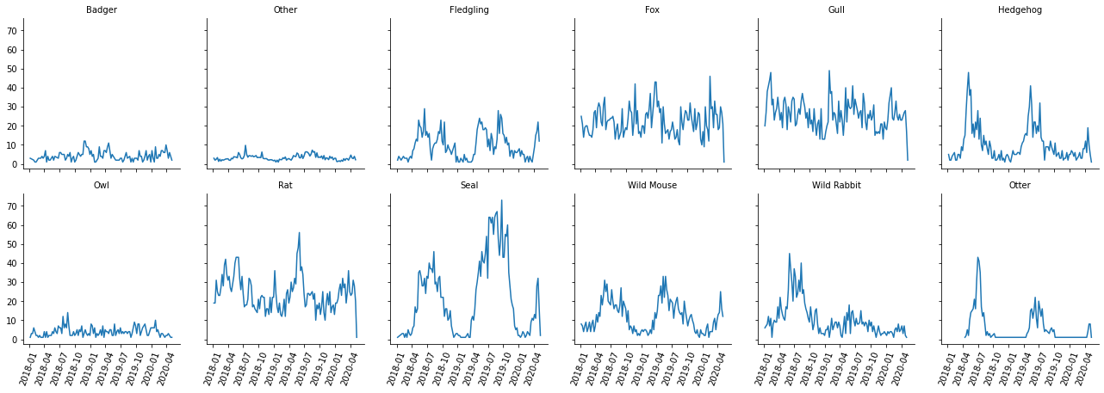
Notes:
Seasonal pattern - hedgehog, seal, wild mouse, otter

Slide 13
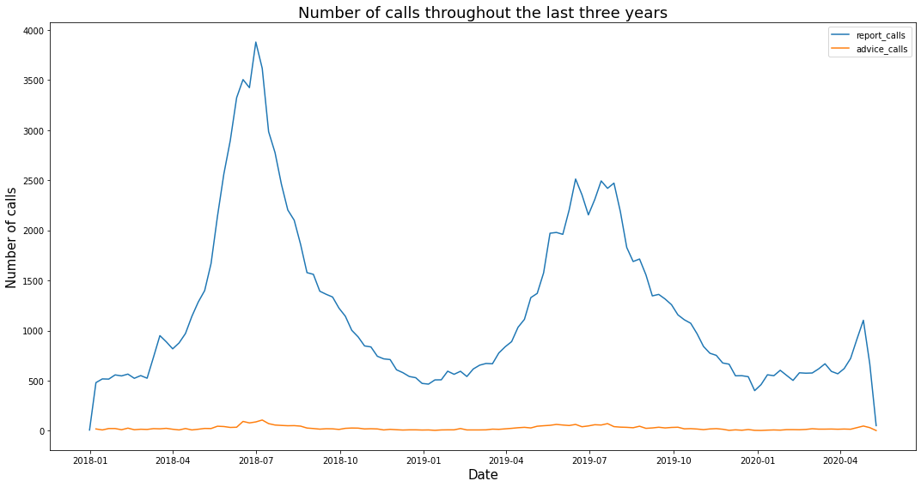
Q3: Total call volume for Advice calls how has this trended over the last two years

Slide 14
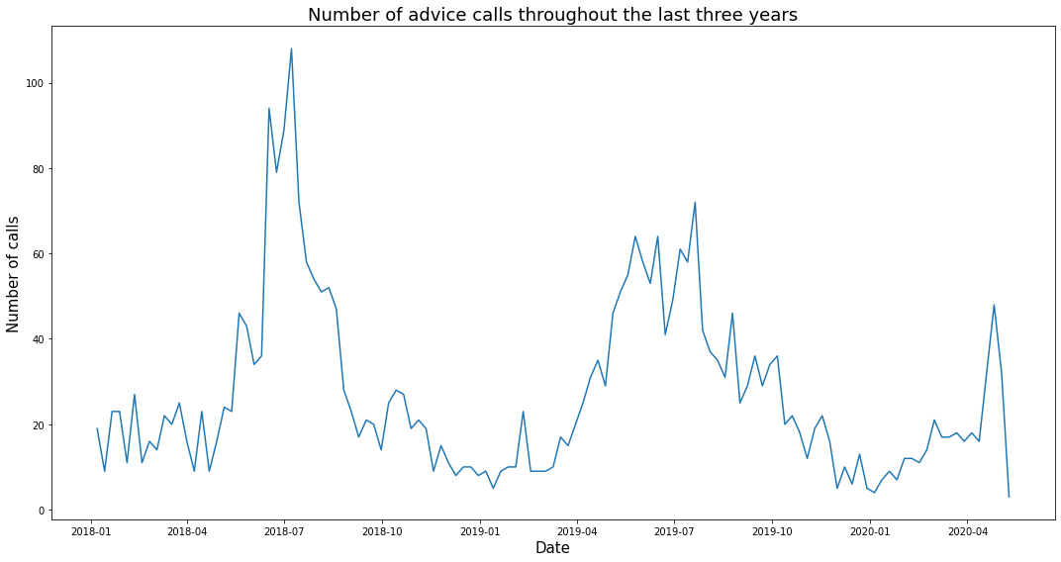
Q3: Total call volume for Advice calls how has this trended over the last two years.

Slide 15
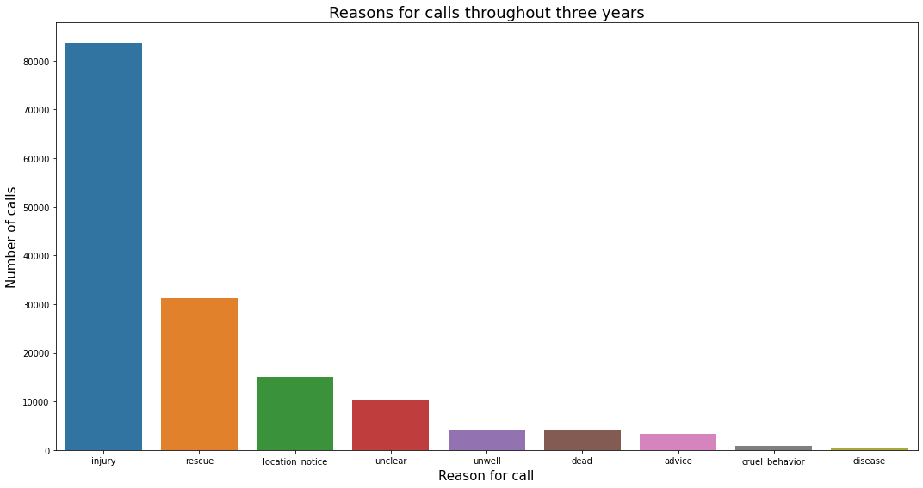
Additionally :
All categories throughout the last three years

Slide 16
Forecasting model

Slide 17
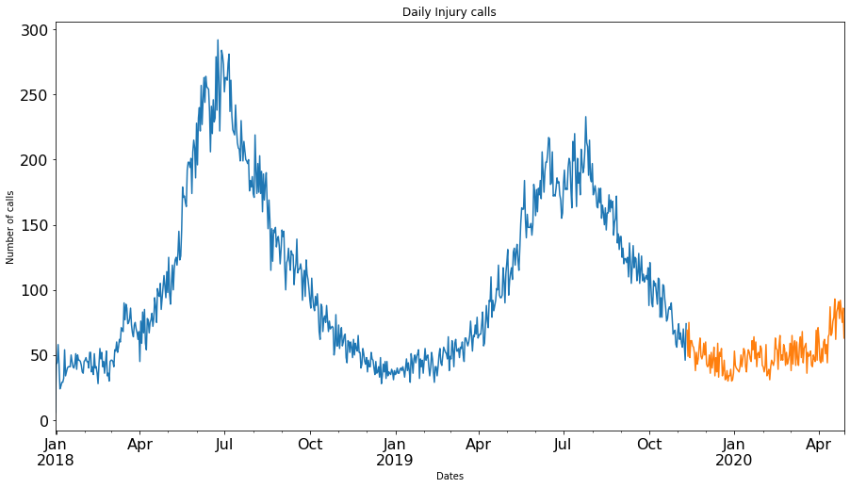
Q4: Business Intelligence – using the insights you have found, can you predict how this might look for 2021 – including predicted call volumes
Notes:
Here data was split into train and test which was 80:20 percent split

Slide 18
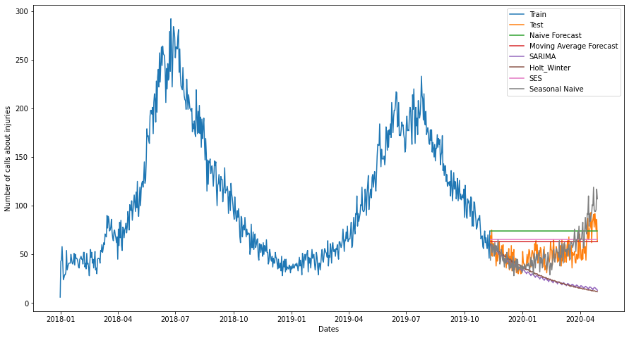
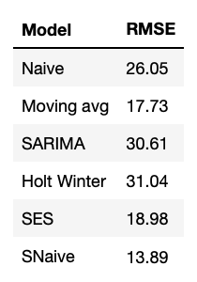
Q4: Business Intelligence – using the insights you have found, can you predict how this might look for 2021 – including predicted call volumes
Notes:
If we want to forecast the price for the next day, we can simply take the last day value and estimate the same value for the next day. Such forecasting technique which assumes that the next expected point is equal to the last observed point is called Naive Method.
we will take the average of the prices for last few time periods only. Obviously the thinking here is that only the recent values matter.
For example it may be sensible to attach larger weights to more recent observations than to observations from the distant past. The technique which works on this principle is called Simple exponential smoothing.
Holt extended simple exponential smoothing to allow forecasting of data with a trend. It is nothing more than exponential smoothing applied to both level(the average value in the series) and trend. The idea behind triple exponential smoothing(Holt’s Winter) is to apply exponential smoothing to the seasonal components in addition to level and trend.
ARIMA models aim to describe the correlations in the data with each other.
RMSE is the metric to test the model.

Slide 19
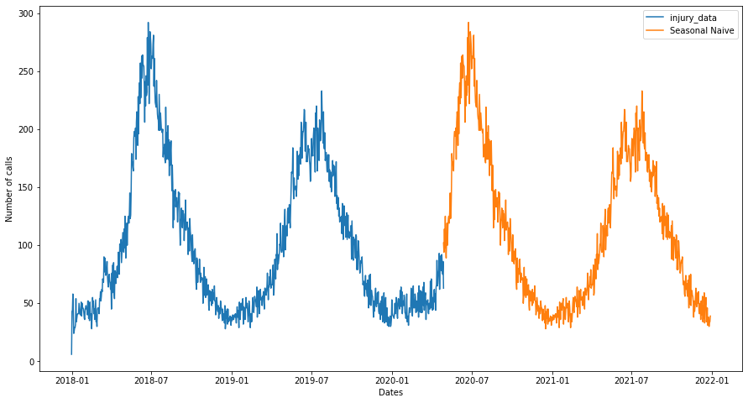
Q4: Business Intelligence – using the insights you have found, can you predict how this might look for 2021 – including predicted call volumes
Notes:
This method is like the naive method but predicts the last observed value of the same season of the year. This method works for highly seasonal data.

Slide 20
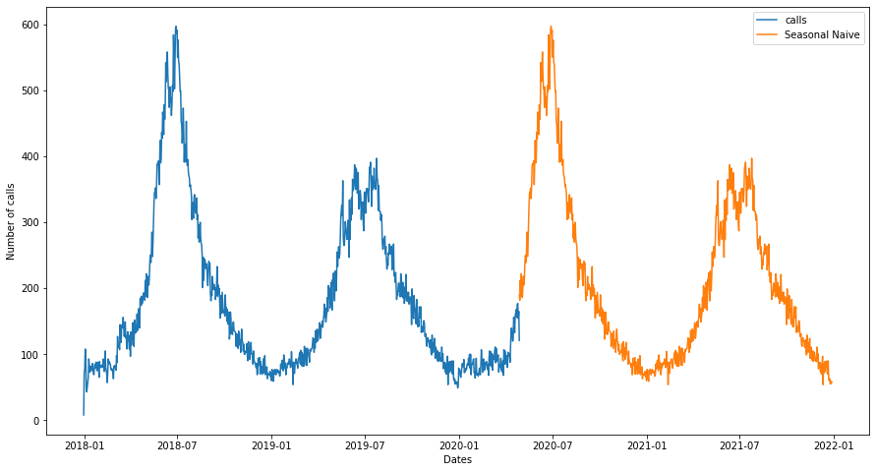
Q4: Business Intelligence – using the insights you have found, can you predict how this might look for 2021 – including predicted call volumes
REQUIRES MORE COMPLEX MODEL!
Notes:
Seasonal Naive (SNaive) model has given the lowest error value.
Prediction model showed the repeat of what happened in the past.
This is what SNaive does.
SNaive is good for predicting few weeks or months ahead but not year or more - it overfits.

Slide 21

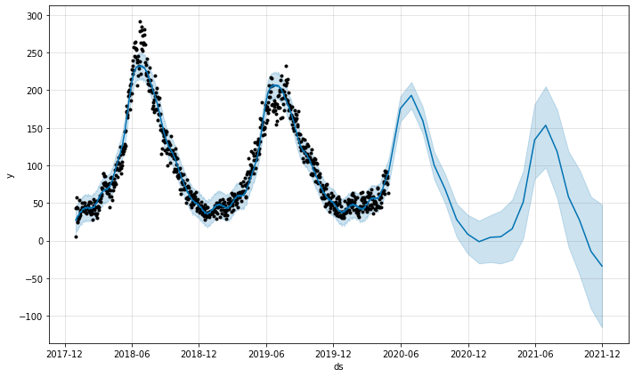
Complex model:
Prophet - Injuries
Notes:
Ds- datestamp
Prophet is a procedure for forecasting time series data based on an additive model where non-linear trends are fit with yearly, weekly, and daily seasonality, plus holiday effects. It works best with time series that have strong seasonal effects and several seasons of historical data.
Prophet is open source software released by Facebook’s Core Data Science team.

Slide 22
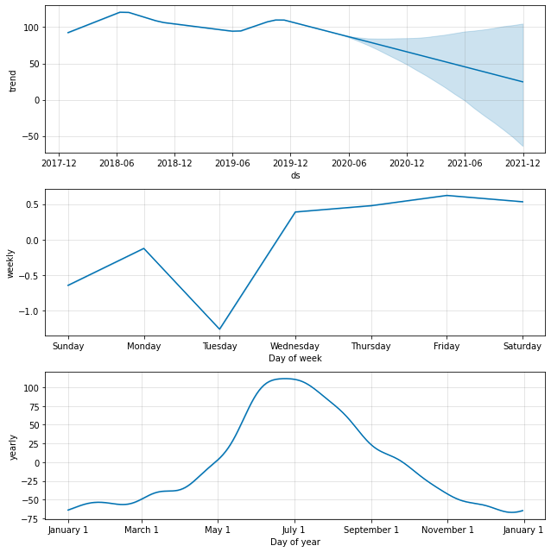
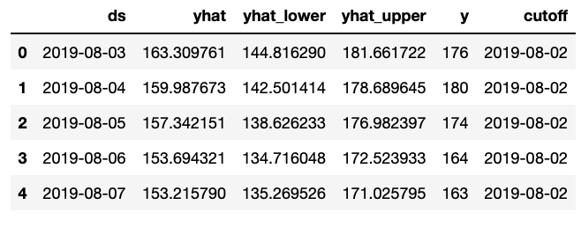
Prophet - Inj components
RMSE = 23.4
Notes:
The goal of cross-validation is to test the model's ability to predict new data that was not used in estimating it, in order to flag problems like overfitting or selection bias and to give an insight on how the model will generalize to an independent dataset (i.e., an unknown dataset, for instance from a real problem).
Cross Validation is a technique which involves reserving a particular sample of a dataset on which you do not train the model. Later, you test your model on this sample before finalizing it.

Slide 23
Summary of Insights
Manchester has the most injuries reported.
All regions have seasonality in injuries reported - summer time. And summer’s 2019 peak is lower than in summer 2018.
Deer accounts for 45% of injuries. Then goose and wild bird.
By around two times more injuries of gull reported in Manchester than in any other region.
Most animals don't have seasonal pattern in injuries but animals with highest injuries do have.
Advice calls have peaks at summer and lower volume of calls in summer 2019.
Seasonal Naive is good for short period prediction. Prophet is good for long term period prediction.
  It picked up the general trend which is a decreasing one.
  However, only 2 seasons of data provided.
Rescue is the second reason for calls after injuries.
Notes:
Hypothesise why there are peaks at summer times but additional investigation required.

Slide 24
Future Proposal
With text data there are more uncertainty.
Dictionary of ‘keywords’ can be completely different for the next data.
Highly advisable:
  1) Create one extra column for category where call person would be able to choose from: injury, rescue, etc.
  2) Move ‘description’ column at the end so data won’t shifted to the right if there is more text to be added. (!)
Optional: Create a 2nd column for category of call type: advice or report.
For future analysis:
  Create a function for shifting data based on region column.
  Filter the injuries and analyse type of injuries.

Slide 25
Thank you
for listening!
Any Questions?
GitHub: vpetrova13
LinkedIn: veronika-moroz-664448107/

